Slide 1

Developers: Assaf Israel & Eli Nazarov
Written by Assaf Israel & Eli Nazarov ©

Slide 2

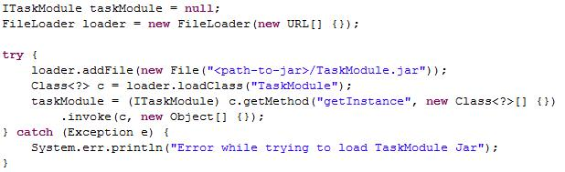
ITaskModule, IExperiment & IDataModel will be available via Standards.jar
Concrete implementation will be available via a the TaskModule.Jar
Dynamically load jar file to ITaskModule
(almost like games)
Written by Assaf Israel & Eli Nazarov ©

Slide 3

You know your program best
  Methods/Variables names
  Some methods may not exists
  Implementation independent
Call it what you want, and let us know when it happens
Written by Assaf Israel & Eli Nazarov (c)

Slide 4

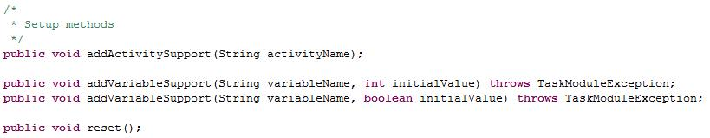
Declare and name your “Activities”
Declare and name your Variables
  Currently we’re supporting Boolean & Integer var.
Written by Assaf Israel & Eli Nazarov (c)

Slide 5

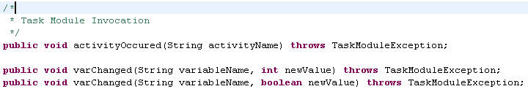
You are responsible for letting us know when Activities occur & when Variables change.
Written by Assaf Israel & Eli Nazarov ©

Slide 6

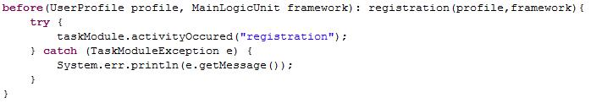
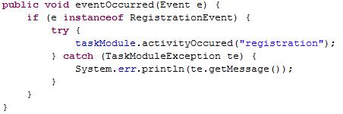
AspectJ
Events
Written by Assaf Israel & Eli Nazarov (c)

Slide 7


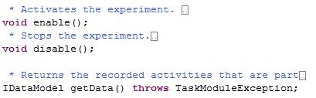
Tasks are compiled ConGlog scripts
Experiments are smart Task containers
  Serves as a Set of Tasks
  You can Enable/Disable Experiment recording
Written by Assaf Israel & Eli Nazarov ©

Slide 8

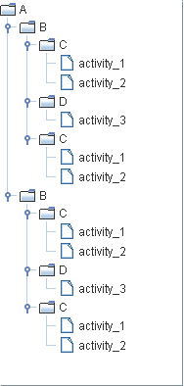
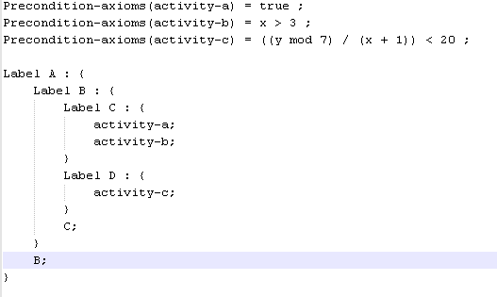
Task Creation
  ConGlog scripts are compiled to Tasks
ConGlog Script
Written by Assaf Israel & Eli Nazarov ©

Slide 9

Experiment Management
  Experiment recording can be enabled/disabled
  (via IExperiment interface)
Data Model
  Generic storage of data.
  Can be exported to CSV file.
  Experiment scope.
  Task Module scope.
Written by Assaf Israel & Eli Nazarov ©

Slide 10

Default Analyzer
(via IDataModel interface)
Written by Assaf Israel & Eli Nazarov ©

Slide 11

The following example is an end to end simple scenario implementation using AspectJ
Written by Assaf Israel & Eli Nazarov (c)

Slide 12

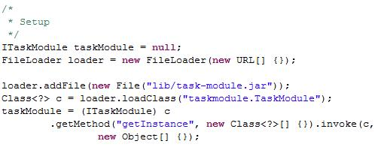
task-module.jar has been put in lib folder
load the concrete “taskmodule.TaskModule” class
Interfaces are available via Standards.jar
ITaskModule is design as a singleton, so use “getInstance”
Written by Assaf Israel & Eli Nazarov (c)

Slide 13


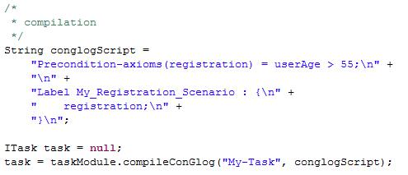
We’ll demonstrate a simple registration scenario
The following script, checks if the user age is above 55
Written by Assaf Israel & Eli Nazarov (c)

Slide 14

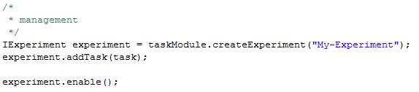
We’ll create a new experiment with the compiled task and enable the recording for it.
Written by Assaf Israel & Eli Nazarov (c)

Slide 15

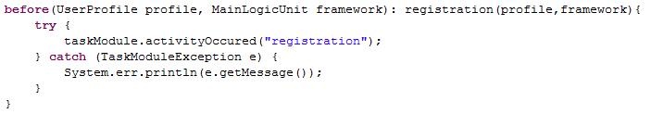
Registration pointcut
Registration advice
Written by Assaf Israel & Eli Nazarov (c)

Slide 16

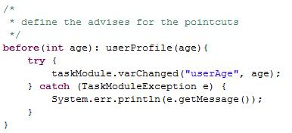
User age pointcut
User age advice
Written by Assaf Israel & Eli Nazarov (c)

Slide 17


After we’ve played a bit with the system, we’re ready to get the results
Export them to a file
Written by Assaf Israel & Eli Nazarov (c)

